Slide 1
PLATE TECTONICS
Chapter 8

Slide 2
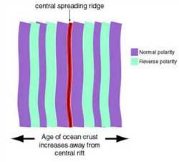
Magnetism
Evidence that supports the theory comes from the magnetic properties and ages of igneous rock on the ocean floor.
Some of the rocks record reversals in the direction of the Earth’s magnetic field
South magnetic pole
North magnetic pole

Slide 3
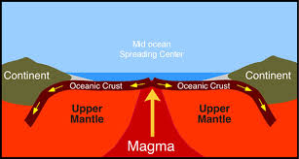
Mid-Ocean Ridges
Long chain of volcanic mountains on the ocean floor
Magnetic reversals are recorded in bands of rock on either side of a mid-ocean ridge

Slide 4
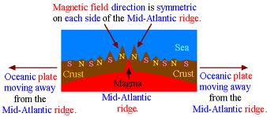
Magnetism

Slide 5
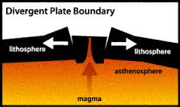
Divergent Boundaries
Between 2 lithospheric plates that are moving apart. **Most are along the ocean floor
Have rift valleys: deep valleys at the center of mid-ocean ridge.
Process sometimes called sea-floor spreading

Slide 6
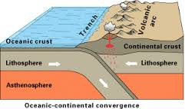
Convergent Boundaries
Boundary between 2 plates that are moving toward each other.
Subduction Boundary: an oceanic plate plunges beneath another plate
Deep-sea trench: long deep trench that forms along the boundary.

Slide 7
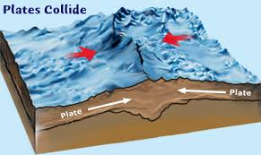
Convergent Boundaries
Collision Boundary: 2 converging plates carry continents, the 2 continents may become welded into a single, larger continent.
The collision causes the crust to be pushed upward into a mountain range.

Slide 8
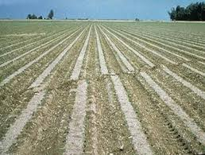
Transform Boundaries
Where 2 plates are sliding past each other.
Fracture zones that off-set the mid-ocean ridge are transform boundaries

Slide 9
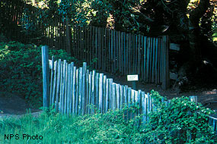
1906 San Francisco Earthquake
http://www.nps.gov/pore/naturescience/geologicactivity.htm

Slide 10
San Andreas Fault
Movement along the San Andreas Fault ranges from about 3.5-5 cm (1.4 to 2 inches) a year (about the speed your fingernails grow). However, instead of creeping along at a slow steady pace, the plates lock together for many years and build up tremendous amounts of stress. When the plates slip and release the stress, waves of energy are sent out and are experienced as an earthquake. The last time the plates here slipped by each other was during the great San Francisco Earthquake of 1906. The greatest displacement in this area was about 7.5 meters (24.5 feet)!

Slide 11
Photos
Various types of faults showing obvious shifts in land

Slide 12
Causes of Plate Movement
3 Major Hypotheses:
Mantle Convection
Ridge Push
Slab Pull
* Asthenosphere… What is it???

Slide 13
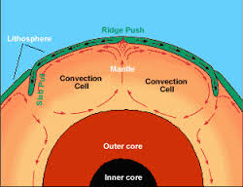
Mantle Convection
Heat from the Earth’s inner & outer core is transferred through the mantle by the process of mantle convection
Magma that is hotter (less dense) rises upward at the mid-ocean ridge (convection cell)

Slide 14
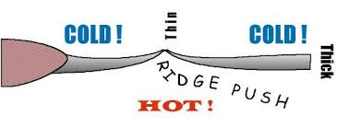
Ridge Push
Rock that forms from magma is very hot at first, it is less dense than the rocks farther away from the mid-ocean ridge
Gravity causes the older, denser lithosphere to slide away from the ridge
New molten magma wells up at the mid-ocean ridge

Slide 15
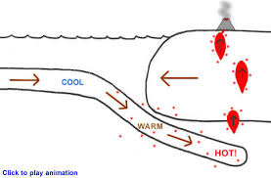
Slab Pull
At a subduction boundary one plate is denser and heavier than another.
The denser plate, begins to subduct
Edge of subducting plate is colder/heavier than mantle, so it continues to sink pulling the rest of the plate with it.

Slide 16
You Try
Construct a model that shows the processes of ridge push and slab pull.

Slide 17
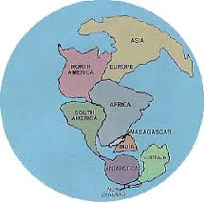
Plate Movement & Continental Growth
Pangaea

Slide 18
Evidence
Ural Mountains in Russia
Appalachian Mountains in E. US
Both show evidence of past subduction (convergent boundary)
Neither is near a plate boundary today

Slide 19
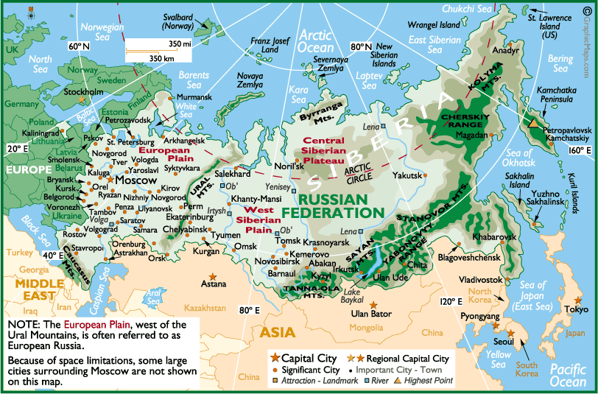
Ural Mountains

Slide 20
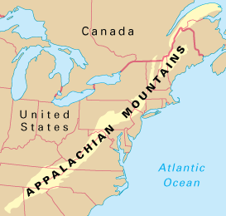
Appalachian Mountains

Slide 21
Evidence
Fossils also provide clues
Fossils of organisms that once lived in shallow seas have been found on mountain tops
Other, Rocks that show evidence of once being covered by glaciers, now lie in tropical regions of Southern Hemishpere

Slide 22
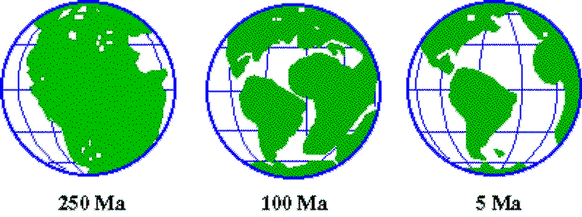
PT & Continental Growth
The ancestors of most modern continents were smaller.
Processes associated with plate movements have added rock materials to the margins
The shapes that we see today have formed gradually

Slide 23
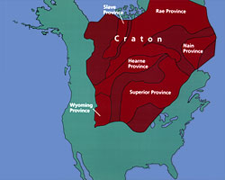
Craton
At the core of each continent is an expanse of ancient rock called the craton

